Slide 1
Workshop 2

Slide 2
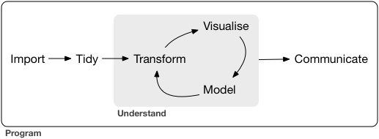
Where are we?

Slide 3
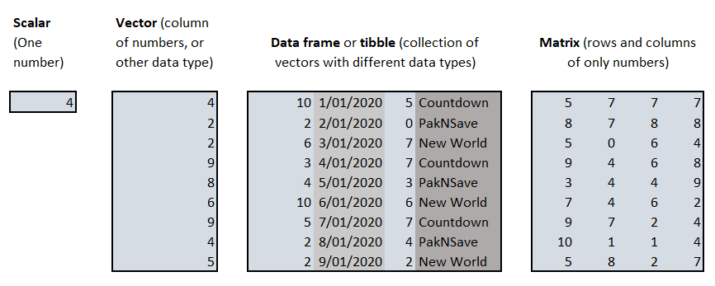
Data in R

Slide 4
Data in R

Slide 5
Data in R

Slide 6
Data in R

Slide 7
Piping
delays <- flights %>%
group_by(dest) %>%
summarise( count = n(), dist = mean(distance, na.rm = TRUE), delay = mean(arr_delay, na.rm = TRUE) ) %>%
filter(count > 20, dest != "HNL")
flights
group_by(arg1, dest)
summarise(arg1, count = n(), dist = mean(distance, na.rm = TRUE), delay = mean(arr_delay, na.rm = TRUE) )
filter(arg1, count > 20, dest != "HNL")

Slide 8
Piping
delays <- flights %>%
group_by(dest) %>%
summarise( count = n(), dist = mean(distance, na.rm = TRUE), delay = mean(arr_delay, na.rm = TRUE) ) %>%
filter(count > 20, dest != "HNL")
flights
group_by(arg1, dest)
summarise(arg1, count = n(), dist = mean(distance, na.rm = TRUE), delay = mean(arr_delay, na.rm = TRUE) )
filter(arg1, count > 20, dest != "HNL")

Slide 9
Piping
delays <- flights %>%
group_by(dest) %>%
summarise( count = n(), dist = mean(distance, na.rm = TRUE), delay = mean(arr_delay, na.rm = TRUE) ) %>%
filter(count > 20, dest != "HNL")
flights
group_by(arg1, dest)
summarise(arg1, count = n(), dist = mean(distance, na.rm = TRUE), delay = mean(arr_delay, na.rm = TRUE) )
filter(arg1, count > 20, dest != "HNL")

Slide 10
Piping
delays <- flights %>%
group_by(dest) %>%
summarise( count = n(), dist = mean(distance, na.rm = TRUE), delay = mean(arr_delay, na.rm = TRUE) ) %>%
filter(count > 20, dest != "HNL")
flights
group_by(arg1, dest)
summarise(arg1, count = n(), dist = mean(distance, na.rm = TRUE), delay = mean(arr_delay, na.rm = TRUE) )
filter(arg1, count > 20, dest != "HNL")

Slide 11
Piping
delays <- flights %>%
group_by(dest) %>%
summarise( count = n(), dist = mean(distance, na.rm = TRUE), delay = mean(arr_delay, na.rm = TRUE) ) %>%
filter(count > 20, dest != "HNL")
flights
group_by(arg1, dest)
summarise(arg1, count = n(), dist = mean(distance, na.rm = TRUE), delay = mean(arr_delay, na.rm = TRUE) )
filter(arg1, count > 20, dest != "HNL")
delays

Slide 12
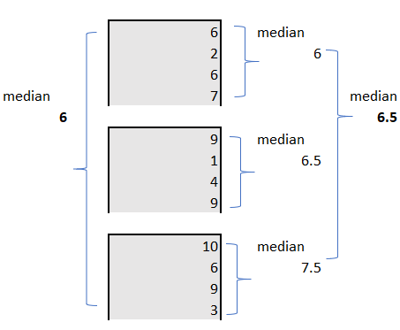
Does grouping affect statistics?

Slide 13
Does grouping affect statistics?

Slide 14
Does grouping affect statistics?

Slide 15
Homework
Finish Chapter 5 (Ex 5.6.7)
Do exercises 6.3 from R4DS
And of course 1 to 6!

